Slide 1




Mini Project
Final Presentation
Instructed By – Professor Sekhar Mandal

Slide 2
Pasumarthi Venkata Siva Sandeep
510519074,
3rd Semester,
Computer Science and Technology Department,
IIEST Shibpur.

Slide 3
Motivation
Step by step implementation of some of the image processing techniques.
Every program is written in C programming language which will help to master the C programming language.

Slide 4
Task 1 – Reading and Writing an Image
The first step is to read an image file with .png extension and store it in an array.
The second step is to write the stored image in new location given by the user.

Slide 5
Theoretical Background
The .png file that is exists in the system in ascii format so that we can store them in arrays or any other data structure.
The 1st line of the file contain the header name, 2nd line of the file contain number of columns and number of rows with a space in between them and the 3rd line contain the maximum value of the pixel that the image file having.
In each of remaining columns x rows number of lines will contain the pixel values of the image.

Slide 6
Use Cases
For getting copies of the same image.
To store the same image in different locations.
To store the same image with different names.

Slide 7
Task 2 – Mean Image Filtering
Traversing a n x n window through the image array and taking the mean of the every pixel value except (n-1) x (n-1) pixel value inside the window.
Assigning the mean to the (n-1) x (n-1) location.

Slide 8
Theoretical Background
In an image if it is having noise at a location, taking the mean value of the neighbours can reduce the noise.
But the image will get blurred according to the window size.

Slide 9
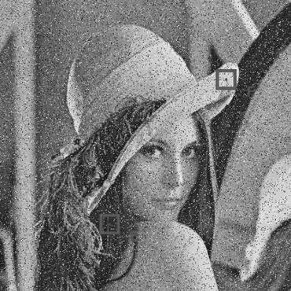

Comparison of image before and after mean filtering
Actual Image
Image after mean filtering

Slide 10
Use Cases
To reduce noise of the image.
To make an image blur.

Slide 11
Task 3 – Median Image Filtering
Traversing a n x n window through the image array and taking the median of the every pixel value except (n-1) x (n-1) pixel value inside the window.
Assigning the median to the (n-1) x (n-1) location.

Slide 12
Theoretical Background
In an image if it is having noise at a location, taking the median value of the neighbours can reduce the noise.
But the image will get blurred according to the window size.

Slide 13
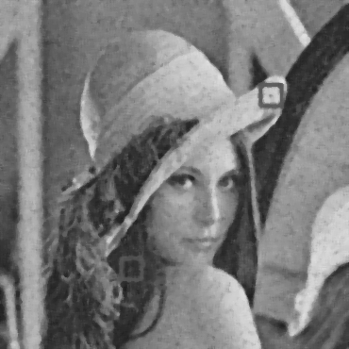
Comparison of image before and after median filtering
Actual Image
Image after median filtering

Slide 14
Use Cases
To reduce noise of the image.
To make an image blur.

Slide 15
Task 4 – Binarization
Finding an optimum pixel value for making the background separated from foreground.
Every pixel that is above optimum value is 0 and the pixel value below optimum value is 1 or 256.

Slide 16
Theoretical Background
Otsu algorithm is used to find the optimum value.
Otsu algorithm will use histograms for finding optimum value for image thresholding.

Slide 17


Comparison of image before and after binarization
Actual Image
Image after binarization

Slide 18
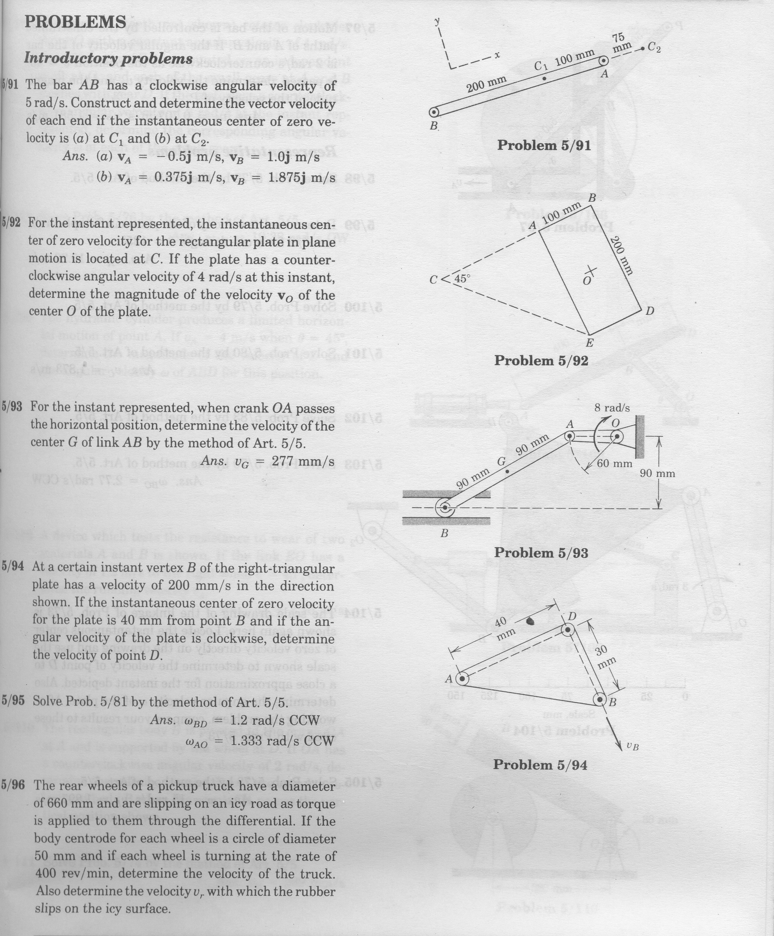
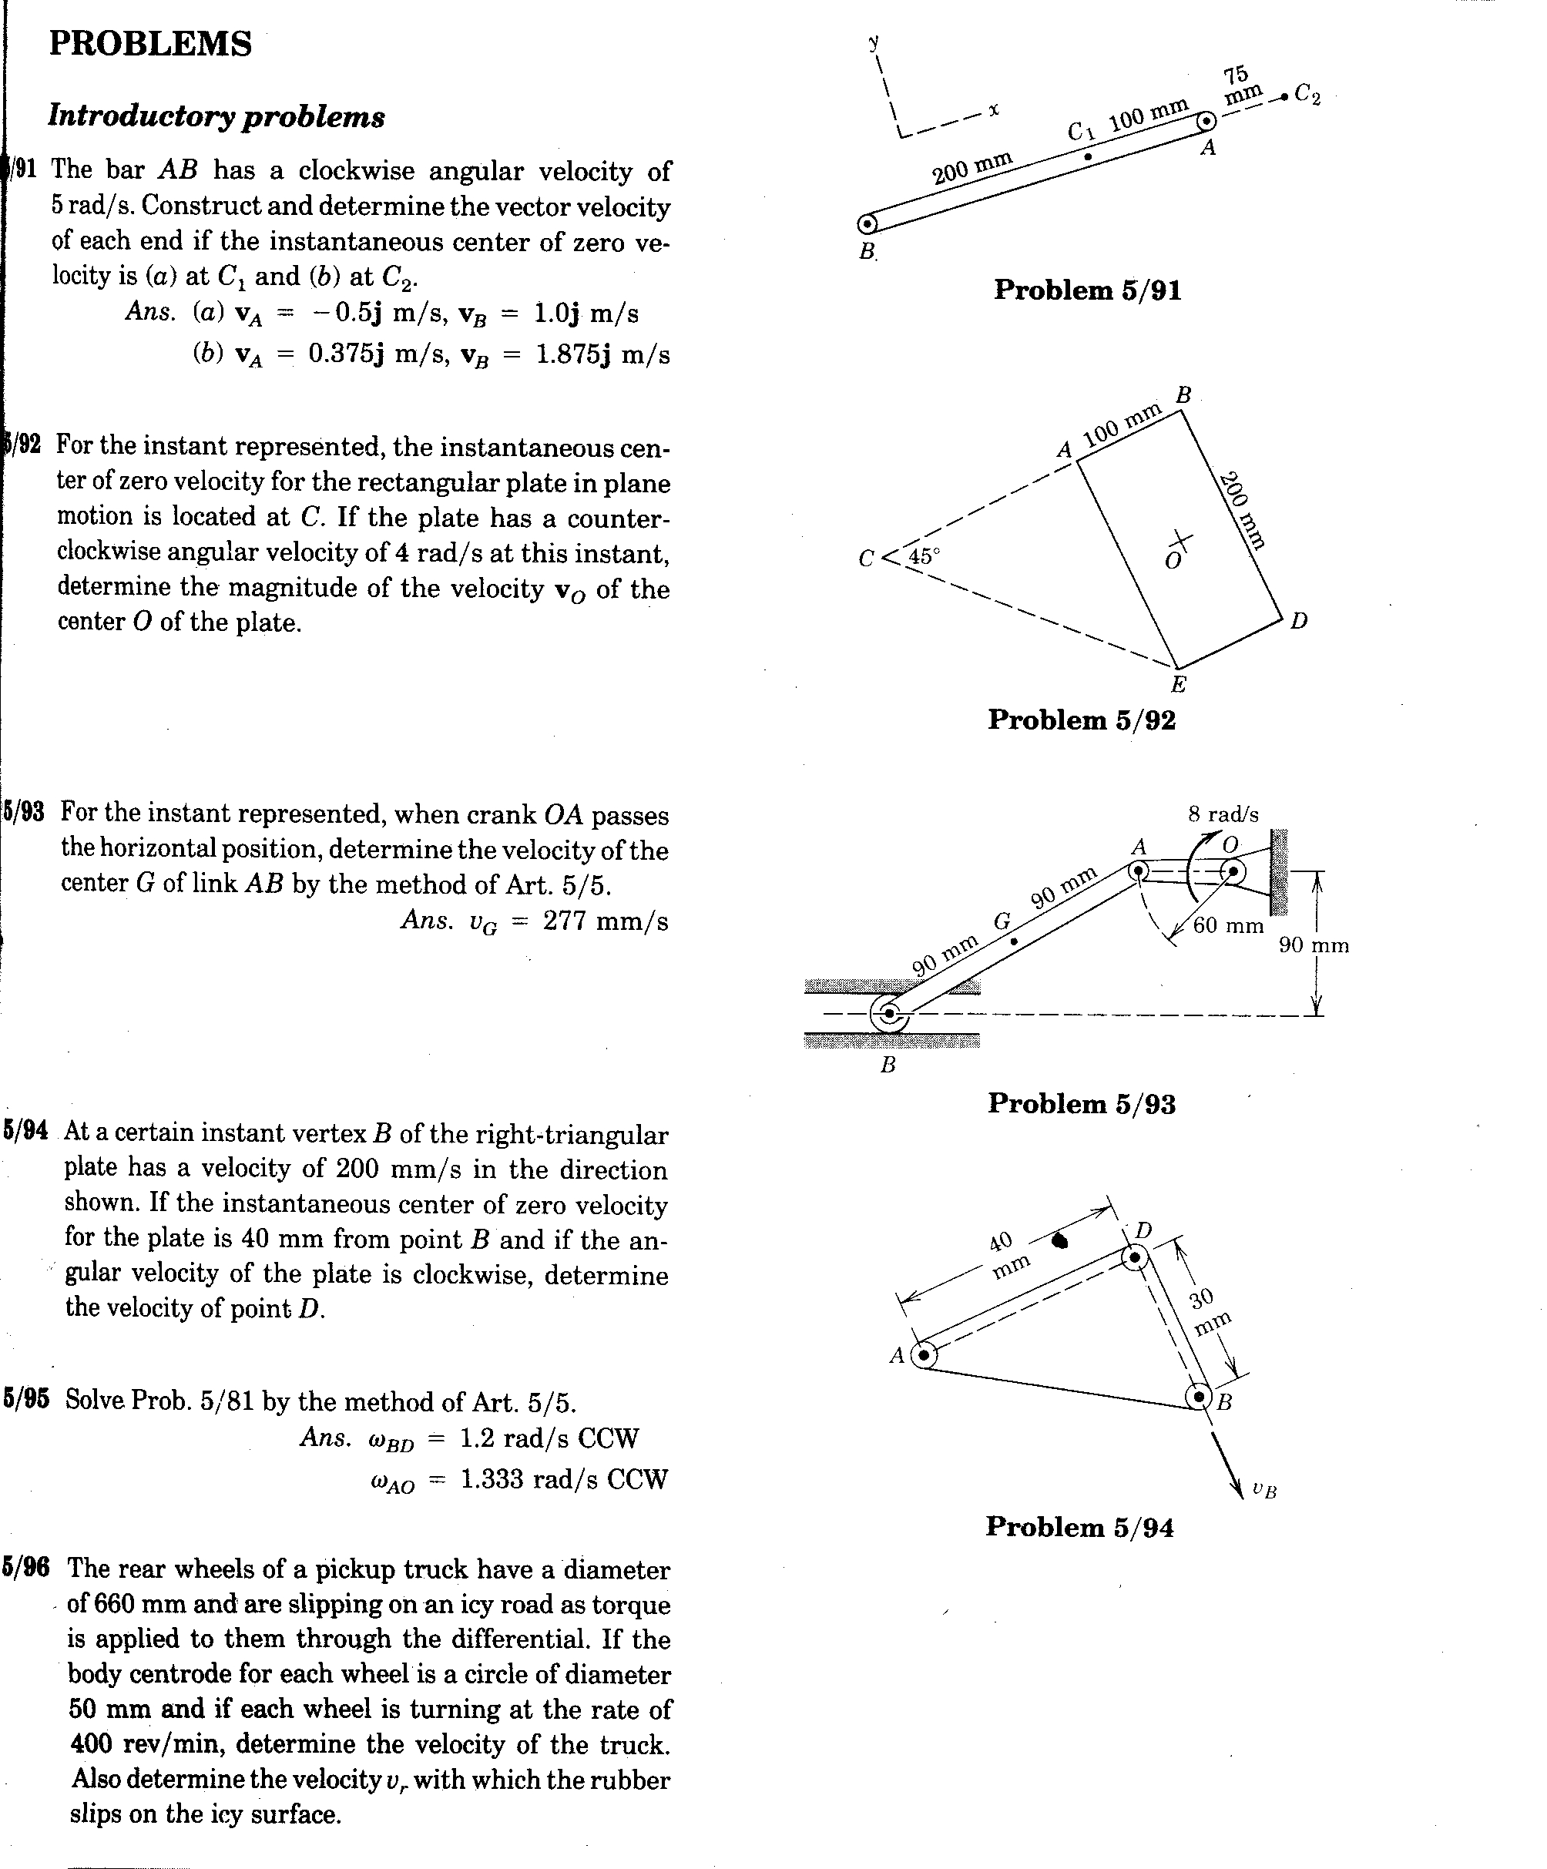
Comparison of image before and after binarization
Actual Image
Image after binarization

Slide 19
Use Cases
To find the important things in the image like finding the location of tumour cell from an image.
To separate background from foreground.

Slide 20
Task 5 – Connected Component Labelling
It(CCL) is a basic algorithm in image processing and an essential step in nearly every application dealing with object detection.
It groups together pixels belonging to the same connected component.

Slide 21
Theoretical Background
Connected component labeling works by scanning an image, pixel-by-pixel (from top to bottom and left to right) in order to identify connected pixel regions, i.e., regions of adjacent pixels which share the same set of intensity values V.
Connected component labeling works on binary or gray level images and different measures of connectivity are possible. we assume binary input images and 8- connectivity. The connected components labeling operator scans the image by moving along a row until it comes to a point p (where p denotes the pixel to be labeled at any stage in the scanning process) for which V={1}. When this is true, it examines the eight neighbors of p which have already been encountered in the scan
After completing the scan, the equivalent label pairs are sorted into equivalence classes and a unique label is assigned to each class. As a final step, a second scan is made through the image, during which each label is replaced by the label assigned to its equivalence classes. For display, the labels might be different graylevels or colors.

Slide 22
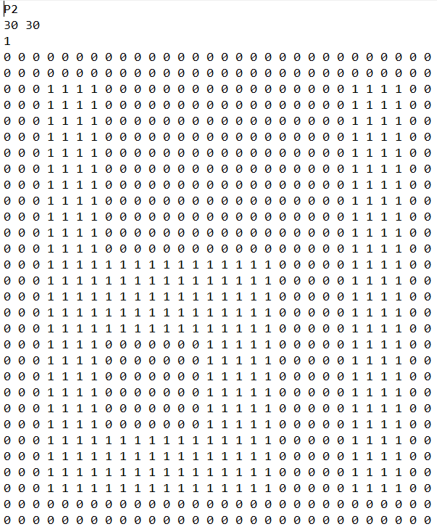
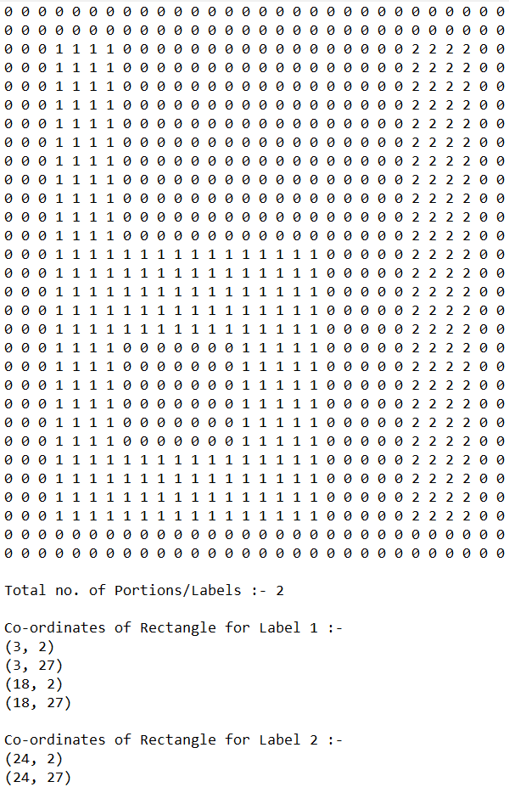
Actual binary image VS Labeled image
Actual Image in Note Pad
Labeled Output

Slide 23
Use Cases
To find number of components in the binary image.
For image Segmentation.

Slide 24
For source code click below
https://github.com/Sandeep-Pasumarthi/MiniProject/tree/main/MiniProject3

Slide 25
Thank You

